Slide 1
Applied Studies - Information Technology
Year 9 and/or 10

Slide 2
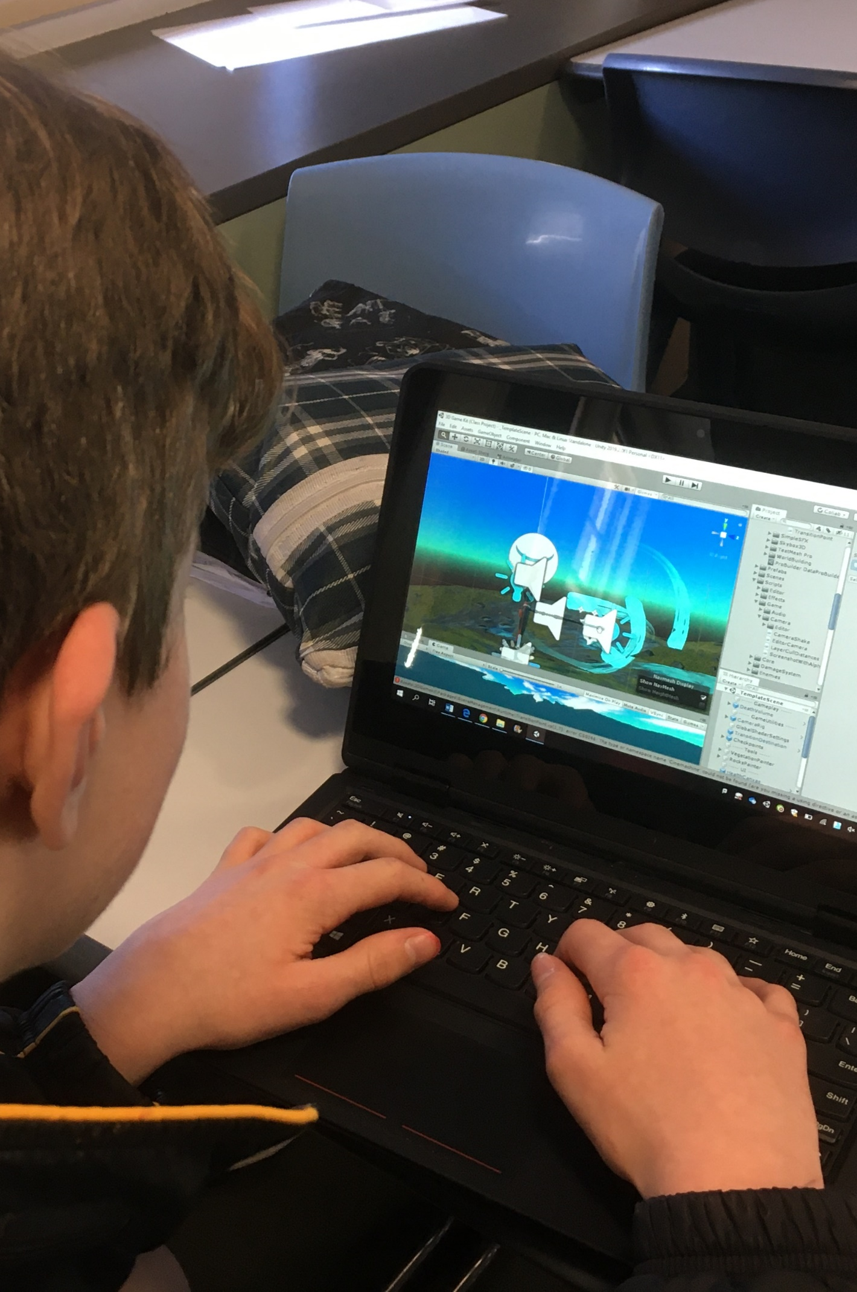
Information Technology
1 or 2 year course
Mix of theory and practical
Learn to code in Python and HTML/CSS
Focus on cyber security
Investigate computers networks
Develops problem solving skills, critical thinking skills and design skills
Individual projects and group work
Real world projects

Slide 3
Find out more…
Please feel free to contact Mrs Selina Kinne, Head of Technology and Applied Studies, at skinne@dominic.tas.edu.au

